Slide 1
Introduction to Java
Arrays

Slide 2
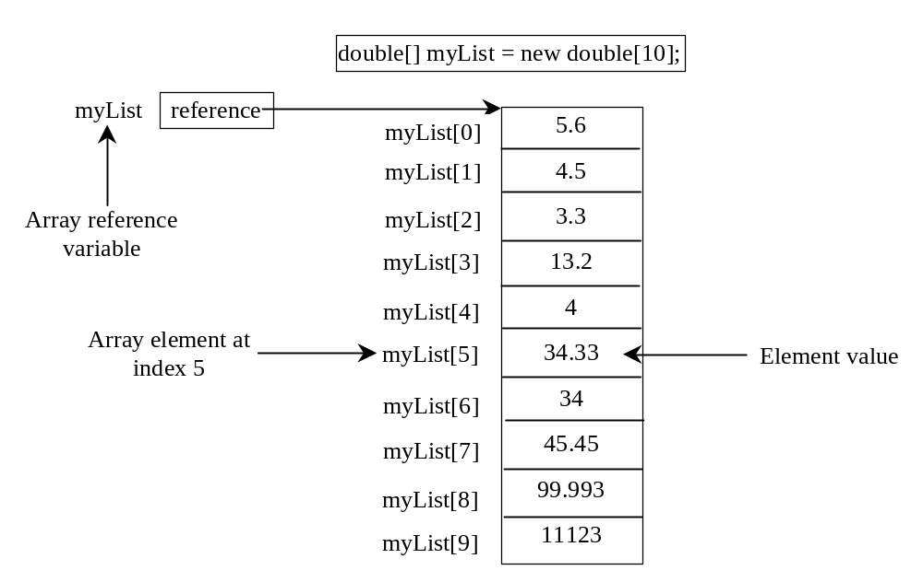
Introducing Arrays
Array is a data structure that represents a collection of the same types of data.

Slide 3
Declaring Array Variables
datatype[] arrayRefVar;
Example:
double[] myList;
datatype arrayRefVar[];
// This style is allowed, but not preferred
Example:
double myList[];

Slide 4
Creating Arrays
arrayRefVar = new datatype[arraySize];
Example:
myList = new double[10];
myList[0] references the first element in the array.
myList[9] references the last element in the array.

Slide 5
Declaring and Creating in One Step
datatype[] arrayRefVar = new datatype[arraySize];
double[] myList = new double[10];
datatype arrayRefVar[] = new datatype[arraySize];
double myList[] = new double[10];

Slide 6
The Length of an Array
Once an array is created, its size is fixed. It cannot be changed. You can find its size using
    arrayRefVar.length
For example,
    myList.length returns 10

Slide 7
Default Values
When an array is created, its elements are assigned the default value of
  0 - for the numeric primitive data types,
  '\u0000' - for char types, and
  false - for boolean types.

Slide 8
Indexed Variables
The array elements are accessed through the index.
The array indices are 0-based, i.e., it starts from 0 to arrayRefVar.length-1.
Each element in the array is represented using the following syntax, known as an indexed variable:
  arrayRefVar[index];

Slide 9
Using Indexed Variables
After an array is created, an indexed variable can be used in the same way as a regular variable.
For example, the following code adds the value in myList[0] and myList[1] to myList[2].
  myList[2] = myList[0] + myList[1];

Slide 10
Array Initializers
Declaring, creating, initializing in one step:
double[] myList = {1.9, 2.9, 3.4, 3.5};
This shorthand syntax must be in one statement.

Slide 11
Declaring, creating, initializing Using the Shorthand Notation
double[] myList = {1.9, 2.9, 3.4, 3.5};
This shorthand notation is equivalent to the following statements:
double[] myList = new double[4];
myList[0] = 1.9;
myList[1] = 2.9;
myList[2] = 3.4;
myList[3] = 3.5;

Slide 12
CAUTION
Using the shorthand notation, you have to declare, create, and initialize the array all in one statement.
Splitting it would cause a syntax error. For example, the following is wrong:
  double[] myList;
  myList = {1.9, 2.9, 3.4, 3.5};

Slide 13
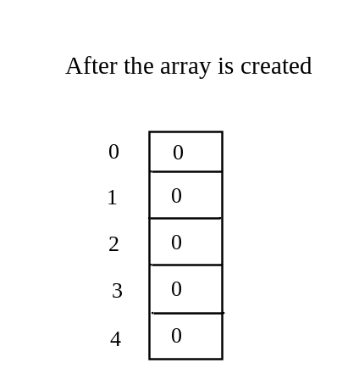
Trace Program with Arrays
Declare array variable values, create an array, and assign its reference to values
public class Test {
public static void main(String[] args) {
int[] values = new int[5];
for (int i = 1; i < 5; i++) {
values[i] = i + values[i-1];
}
values[0] = values[1] + values[4];
}
}

Slide 14
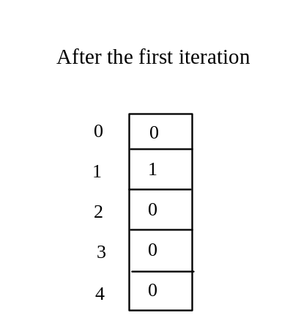
Trace Program with Arrays
After this line is executed, value[1] is 1
public class Test {
public static void main(String[] args) {
int[] values = new int[5];
for (int i = 1; i < 5; i++) {
values[i] = i + values[i-1];
}
values[0] = values[1] + values[4];
}
}

Slide 15
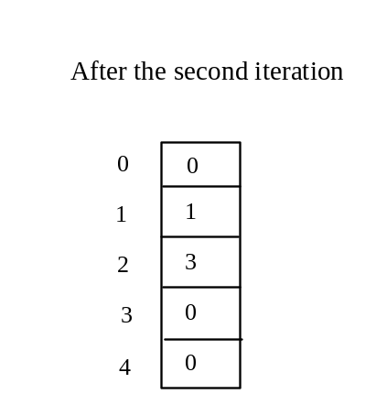
Trace Program with Arrays
Next Iteration: After this line is executed,
values[2] is 3 (2 + 1)
public class Test {
public static void main(String[] args) {
int[] values = new int[5];
for (int i = 1; i < 5; i++) {
values[i] = i + values[i-1];
}
values[0] = values[1] + values[4];
}
}

Slide 16
Trace Program with Arrays
i (=3) is still less than 5.
public class Test {
public static void main(String[] args) {
int[] values = new int[5];
for (int i = 1; i < 5; i++) {
values[i] = i + values[i-1];
}
values[0] = values[1] + values[4];
}
}

Slide 17
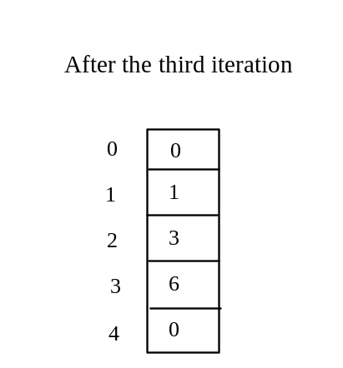
Trace Program with Arrays
After this line, values[3] becomes 6 (3 + 3)
public class Test {
public static void main(String[] args) {
int[] values = new int[5];
for (int i = 1; i < 5; i++) {
values[i] = i + values[i-1];
}
values[0] = values[1] + values[4];
}
}

Slide 18

Trace Program with Arrays
After this, i becomes 4
public class Test {
public static void main(String[] args) {
int[] values = new int[5];
for (int i = 1; i < 5; i++) {
values[i] = i + values[i-1];
}
values[0] = values[1] + values[4];
}
}

Slide 19
Trace Program with Arrays
i (=4) is still less than 5
public class Test {
public static void main(String[] args) {
int[] values = new int[5];
for (int i = 1; i < 5; i++) {
values[i] = i + values[i-1];
}
values[0] = values[1] + values[4];
}
}

Slide 20
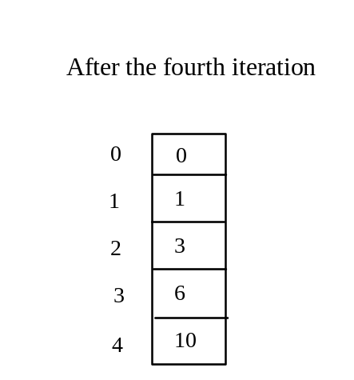
Trace Program with Arrays
After this, values[4] becomes 10 (4 + 6)
public class Test {
public static void main(String[] args) {
int[] values = new int[5];
for (int i = 1; i < 5; i++) {
values[i] = i + values[i-1];
}
values[0] = values[1] + values[4];
}
}

Slide 21
Trace Program with Arrays
After i++, i becomes 5
public class Test {
public static void main(String[] args) {
int[] values = new int[5];
for (int i = 1; i < 5; i++) {
values[i] = i + values[i-1];
}
values[0] = values[1] + values[4];
}
}

Slide 22
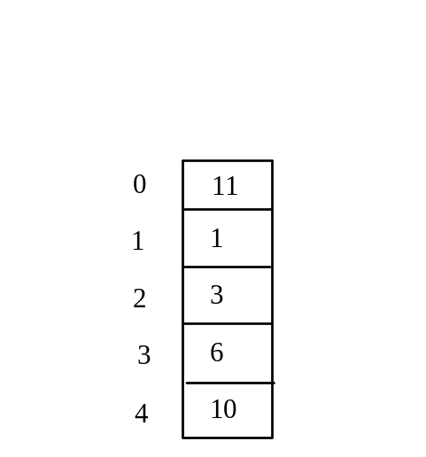
Trace Program with Arrays
After this line, values[0] is 11 (1 + 10)
public class Test {
public static void main(String[] args) {
int[] values = new int[5];
for (int i = 1; i < 5; i++) {
values[i] = i + values[i-1];
}
values[0] = values[1] + values[4];
}
}

Slide 23
Enhanced for Loop (for-each loop)
JDK 1.5 introduced a new for loop that enables you to traverse the complete array sequentially without using an index variable. For example, the following code displays all elements in the array myList:
  for (double value: myList)
  System.out.println(value);
In general, the syntax is
  for (elementType value: arrayRefVar) {
  // Process the value
  }
You still have to use an index variable if you wish to traverse the array in a different order or change the elements in the array.

Slide 24
Analyzing Array Elements - Example
Objective: The program (TestArray) receives 6 numbers from the user, finds the largest number and counts the occurrence of the largest number entered.
Suppose you entered 3, 5, 2, 5, 5, and 5, the largest number is 5 and its occurrence count is 4.

Slide 25
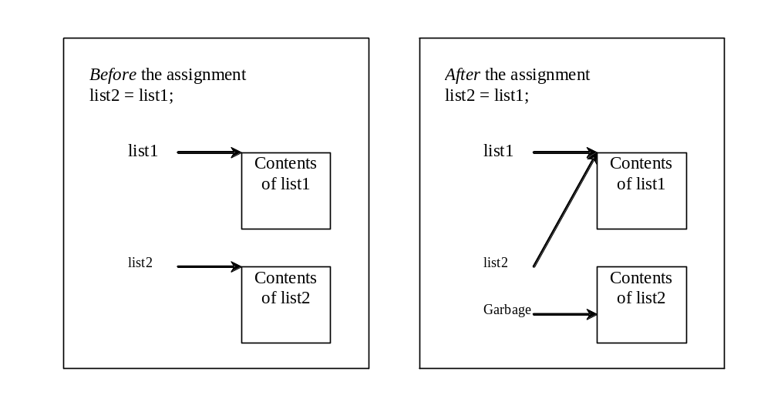
Copying Arrays
Often, in a program, you need to duplicate an array or a part of an array. In such cases you could attempt to use the assignment statement (=), as follows:
list2 = list1;

Slide 26
Copying Arrays
Using a loop:
int[] sourceArray = {2, 3, 1, 5, 10};
int[] targetArray = new int[sourceArray.length];
for (int i = 0; i < sourceArrays.length; i++)
targetArray[i] = sourceArray[i];

Slide 27
The arraycopy Utility
arraycopy(sourceArray,
src_pos,
targetArray,
tar_pos,
length);
Example:
System.arraycopy(sourceArray, 0, targetArray, 0, sourceArray.length);

Slide 28
Passing Arrays to Methods
public static void printArray(int[] array) {
for (int i = 0; i < array.length; i++) {
System.out.print(array[i] + " ");
}
}
Invoke the method:
int[] list = {3, 1, 2, 6, 4, 2};
printArray(list);
Invoke the method:
printArray(new int[]{3, 1, 2, 6, 4, 2});
Anonymous array

Slide 29
Anonymous Array
  The statement
    printArray(new int[]{3, 1, 2, 6, 4, 2});
  creates an array using the following syntax:
    new dataType[]{literal0, literal1, ..., literalk};
  There is no explicit reference variable for the array. Such array is called an anonymous array.

Slide 30
Pass By Value
Java uses pass by value to pass arguments to a method. There are important differences between passing a value of variables of primitive data types and passing arrays.
For a parameter of a primitive type value, the actual value is passed. Changing the value of the local parameter inside the method does not affect the value of the variable outside the method.
For a parameter of an array type, the value of the parameter contains a reference to an array; this reference is passed to the method. Any changes to the array that occur inside the method body will affect the original array that was passed as the argument.

Slide 31
Passing Arrays as Arguments - Example
public class Test {
public static void main(String[] args) {
int x = 1; // x represents an int value
int[] y = new int[10]; // y represents an array of int values
m(x, y); // Invoke m with arguments x and y
System.out.println("x is " + x);
System.out.println("y[0] is " + y[0]);
}
public static void m(int number, int[] numbers) {
number = 1001; // Assign a new value to number
numbers[0] = 5555; // Assign a new value to numbers[0]
}
}

Slide 32
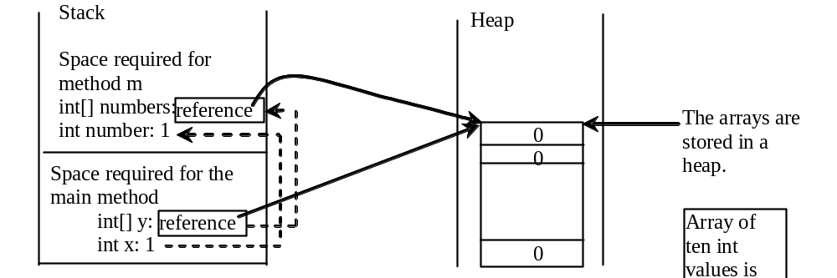
Call Stack
When invoking m(x, y), the values of x and y are passed to number and numbers.
Since y contains the reference value to the array, numbers now contains the same reference value to the same array.

Slide 33
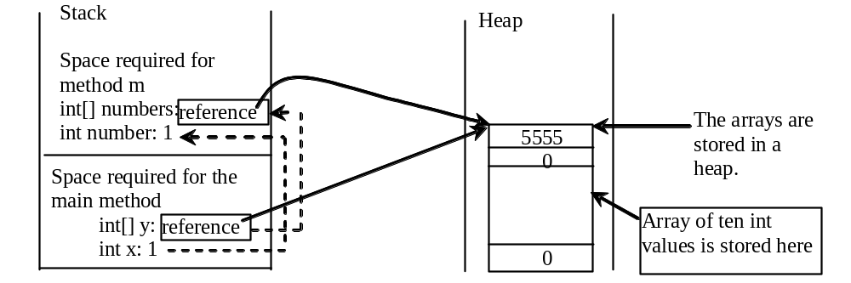
Call Stack
When invoking m(x, y), the values of x and y are passed to number and numbers.
Since y contains the reference value to the array, numbers now contains the same reference value to the same array.

Slide 34
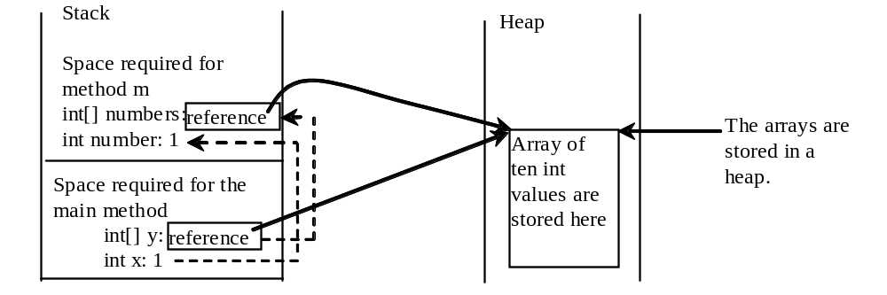
Heap
The JVM stores the array in an area of memory, called heap, which is used for dynamic memory allocation where blocks of memory are allocated and freed in an arbitrary order.

Slide 35
Returning an Array from a Method
public static int[] reverse(int[] list) {
int[] result = new int[list.length];
for (int i = 0, j = result.length - 1;
i < list.length; i++, j--)
{
result[j] = list[i];
}
return result;
}
list
result
int[] list1 = new int[] {1, 2, 3, 4, 5, 6};
int[] list2 = reverse(list1);

Slide 36
Trace the reverse Method
int[] list1 = new int[]{1, 2, 3, 4, 5, 6};
int[] list2 = reverse(list1);
Declare result and create array
public static int[] reverse(int[] list) {
int[] result = new int[list.length];
for (int i = 0, j = result.length - 1;
i < list.length; i++, j--) {
result[j] = list[i];
}
return result;
}
list
1
2
3
4
5
6
result
0
0
0
0
0
0

Slide 37
Trace the reverse Method, cont.
int[] list1 = new int[]{1, 2, 3, 4, 5, 6};
int[] list2 = reverse(list1);
i = 0 and j = 5
public static int[] reverse(int[] list) {
int[] result = new int[list.length];
for (int i = 0, j = result.length - 1;
i < list.length; i++, j--) {
result[j] = list[i];
}
return result;
}
list
1
2
3
4
5
6
result
0
0
0
0
0
0

Slide 38
Trace the reverse Method, cont.
int[] list1 = new int[]{1, 2, 3, 4, 5, 6};
int[] list2 = reverse(list1);
i (= 0) is less than 6
public static int[] reverse(int[] list) {
int[] result = new int[list.length];
for (int i = 0, j = result.length - 1;
i < list.length; i++, j--) {
result[j] = list[i];
}
return result;
}
list
1
2
3
4
5
6
result
0
0
0
0
0
0

Slide 39
Trace the reverse Method, cont.
int[] list1 = new int[]{1, 2, 3, 4, 5, 6};
int[] list2 = reverse(list1);
i = 0 and j = 5
Assign list[0] to result[5]
public static int[] reverse(int[] list) {
int[] result = new int[list.length];
for (int i = 0, j = result.length - 1;
i < list.length; i++, j--) {
result[j] = list[i];
}
return result;
}
list
1
2
3
4
5
6
result
0
0
0
0
0
1

Slide 40
Trace the reverse Method, cont.
int[] list1 = new int[]{1, 2, 3, 4, 5, 6};
int[] list2 = reverse(list1);
After this, i becomes 1 and j becomes 4
public static int[] reverse(int[] list) {
int[] result = new int[list.length];
for (int i = 0, j = result.length - 1;
i < list.length; i++, j--) {
result[j] = list[i];
}
return result;
}
list
1
2
3
4
5
6
result
0
0
0
0
0
1

Slide 41
Trace the reverse Method, cont.
int[] list1 = new int[]{1, 2, 3, 4, 5, 6};
int[] list2 = reverse(list1);
i (=1) is less than 6
public static int[] reverse(int[] list) {
int[] result = new int[list.length];
for (int i = 0, j = result.length - 1;
i < list.length; i++, j--) {
result[j] = list[i];
}
return result;
}
list
1
2
3
4
5
6
result
0
0
0
0
0
1

Slide 42
Trace the reverse Method, cont.
int[] list1 = new int[]{1, 2, 3, 4, 5, 6};
int[] list2 = reverse(list1);
i = 1 and j = 4
Assign list[1] to result[4]
public static int[] reverse(int[] list) {
int[] result = new int[list.length];
for (int i = 0, j = result.length - 1;
i < list.length; i++, j--) {
result[j] = list[i];
}
return result;
}
list
1
2
3
4
5
6
result
0
0
0
0
2
1

Slide 43
Trace the reverse Method, cont.
int[] list1 = new int[]{1, 2, 3, 4, 5, 6};
int[] list2 = reverse(list1);
After this, i becomes 2 and j becomes 3
public static int[] reverse(int[] list) {
int[] result = new int[list.length];
for (int i = 0, j = result.length - 1;
i < list.length; i++, j--) {
result[j] = list[i];
}
return result;
}
list
1
2
3
4
5
6
result
0
0
0
0
2
1

Slide 44
Trace the reverse Method, cont.
int[] list1 = new int[]{1, 2, 3, 4, 5, 6};
int[] list2 = reverse(list1);
i (=2) is still less than 6
public static int[] reverse(int[] list) {
int[] result = new int[list.length];
for (int i = 0, j = result.length - 1;
i < list.length; i++, j--) {
result[j] = list[i];
}
return result;
}
list
1
2
3
4
5
6
result
0
0
0
0
2
1

Slide 45
Trace the reverse Method, cont.
int[] list1 = new int[]{1, 2, 3, 4, 5, 6};
int[] list2 = reverse(list1);
i = 2 and j = 3
Assign list[i] to result[j]
public static int[] reverse(int[] list) {
int[] result = new int[list.length];
for (int i = 0, j = result.length - 1;
i < list.length; i++, j--) {
result[j] = list[i];
}
return result;
}
list
1
2
3
4
5
6
result
0
0
0
3
2
1

Slide 46
Trace the reverse Method, cont.
int[] list1 = new int[]{1, 2, 3, 4, 5, 6};
int[] list2 = reverse(list1);
After this, i becomes 3 and j becomes 2
public static int[] reverse(int[] list) {
int[] result = new int[list.length];
for (int i = 0, j = result.length - 1;
i < list.length; i++, j--) {
result[j] = list[i];
}
return result;
}
list
1
2
3
4
5
6
result
0
0
0
3
2
1

Slide 47
Trace the reverse Method, cont.
int[] list1 = new int[]{1, 2, 3, 4, 5, 6};
int[] list2 = reverse(list1);
i (=3) is still less than 6
public static int[] reverse(int[] list) {
int[] result = new int[list.length];
for (int i = 0, j = result.length - 1;
i < list.length; i++, j--) {
result[j] = list[i];
}
return result;
}
list
1
2
3
4
5
6
result
0
0
0
3
2
1

Slide 48
Trace the reverse Method, cont.
int[] list1 = new int[]{1, 2, 3, 4, 5, 6};
int[] list2 = reverse(list1);
i = 3 and j = 2
Assign list[i] to result[j]
public static int[] reverse(int[] list) {
int[] result = new int[list.length];
for (int i = 0, j = result.length - 1;
i < list.length; i++, j--) {
result[j] = list[i];
}
return result;
}
list
1
2
3
4
5
6
result
0
0
4
3
2
1

Slide 49
Trace the reverse Method, cont.
int[] list1 = new int[]{1, 2, 3, 4, 5, 6};
int[] list2 = reverse(list1);
After this, i becomes 4 and j becomes 1
public static int[] reverse(int[] list) {
int[] result = new int[list.length];
for (int i = 0, j = result.length - 1;
i < list.length; i++, j--) {
result[j] = list[i];
}
return result;
}
list
1
2
3
4
5
6
result
0
0
4
3
2
1

Slide 50
Trace the reverse Method, cont.
int[] list1 = new int[]{1, 2, 3, 4, 5, 6};
int[] list2 = reverse(list1);
i (=4) is still less than 6
public static int[] reverse(int[] list) {
int[] result = new int[list.length];
for (int i = 0, j = result.length - 1;
i < list.length; i++, j--) {
result[j] = list[i];
}
return result;
}
list
1
2
3
4
5
6
result
0
0
4
3
2
1

Slide 51
Trace the reverse Method, cont.
int[] list1 = new int[]{1, 2, 3, 4, 5, 6};
int[] list2 = reverse(list1);
i = 4 and j = 1
Assign list[i] to result[j]
public static int[] reverse(int[] list) {
int[] result = new int[list.length];
for (int i = 0, j = result.length - 1;
i < list.length; i++, j--) {
result[j] = list[i];
}
return result;
}
list
1
2
3
4
5
6
result
0
5
4
3
2
1

Slide 52
Trace the reverse Method, cont.
int[] list1 = new int[]{1, 2, 3, 4, 5, 6};
int[] list2 = reverse(list1);
After this, i becomes 5 and j becomes 0
public static int[] reverse(int[] list) {
int[] result = new int[list.length];
for (int i = 0, j = result.length - 1;
i < list.length; i++, j--) {
result[j] = list[i];
}
return result;
}
list
1
2
3
4
5
6
result
0
5
4
3
2
1

Slide 53
Trace the reverse Method, cont.
int[] list1 = new int[]{1, 2, 3, 4, 5, 6};
int[] list2 = reverse(list1);
i (=5) is still less than 6
public static int[] reverse(int[] list) {
int[] result = new int[list.length];
for (int i = 0, j = result.length - 1;
i < list.length; i++, j--) {
result[j] = list[i];
}
return result;
}
list
1
2
3
4
5
6
result
0
5
4
3
2
1

Slide 54
Trace the reverse Method, cont.
int[] list1 = new int[]{1, 2, 3, 4, 5, 6};
int[] list2 = reverse(list1);
i = 5 and j = 0
Assign list[i] to result[j]
public static int[] reverse(int[] list) {
int[] result = new int[list.length];
for (int i = 0, j = result.length - 1;
i < list.length; i++, j--) {
result[j] = list[i];
}
return result;
}
list
1
2
3
4
5
6
result
6
5
4
3
2
1

Slide 55
Trace the reverse Method, cont.
int[] list1 = new int[]{1, 2, 3, 4, 5, 6};
int[] list2 = reverse(list1);
After this, i becomes 6 and j becomes -1
public static int[] reverse(int[] list) {
int[] result = new int[list.length];
for (int i = 0, j = result.length - 1;
i < list.length; i++, j--) {
result[j] = list[i];
}
return result;
}
list
1
2
3
4
5
6
result
6
5
4
3
2
1

Slide 56
Trace the reverse Method, cont.
int[] list1 = new int[]{1, 2, 3, 4, 5, 6};
int[] list2 = reverse(list1);
i (=6) < 6 is false. So exit the loop.
public static int[] reverse(int[] list) {
int[] result = new int[list.length];
for (int i = 0, j = result.length - 1;
i < list.length; i++, j--) {
result[j] = list[i];
}
return result;
}
list
1
2
3
4
5
6
result
6
5
4
3
2
1

Slide 57
Trace the reverse Method, cont.
int[] list1 = new int[]{1, 2, 3, 4, 5, 6};
int[] list2 = reverse(list1);
Return result
public static int[] reverse(int[] list) {
int[] result = new int[list.length];
for (int i = 0, j = result.length - 1;
i < list.length; i++, j--) {
result[j] = list[i];
}
return result;
}
list
1
2
3
4
5
6
list2
result
6
5
4
3
2
1

Slide 58
Arrays.sort Method
Since sorting is frequently used in programming, Java provides several overloaded sort methods for sorting an array of int, double, char, short, long, and float in the java.util.Arrays class.
For example, the following code sorts an array of numbers and an array of characters.
  double[] numbers = {6.0, 4.4, 1.9, 2.9, 3.4, 3.5};
  java.util.Arrays.sort(numbers);
  char[] chars = {'a', 'A', '4', 'F', 'D', 'P'};
  java.util.Arrays.sort(chars);

Slide 59
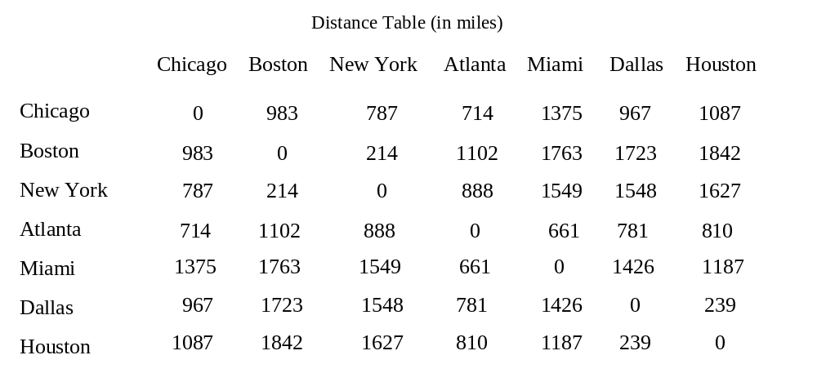
Two-dimensional Arrays
One-dimensional arrays to model linear collections of elements.
Two-dimensional array to represent a matrix or a table.
For example, the following table that describes the distances between the cities can be represented using a two-dimensional array.

Slide 60
Declare/Create Two-dimensional Arrays
// Declare array ref var
dataType[][] refVar;
// Create array and assign its reference to variable
refVar = new dataType[10][10];
// Combine declaration and creation in one statement
dataType[][] refVar = new dataType[10][10];
// Alternative syntax
dataType refVar[][] = new dataType[10][10];

Slide 61
Declare/Create Two-dimensional Arrays
int[][] matrix = new int[10][10];
or
int matrix[][] = new int[10][10];
matrix[0][0] = 3;
for (int i = 0; i < matrix.length; i++)
for (int j = 0; j < matrix[i].length; j++)
matrix[i][j] = (int)(Math.random() * 1000);

Slide 62
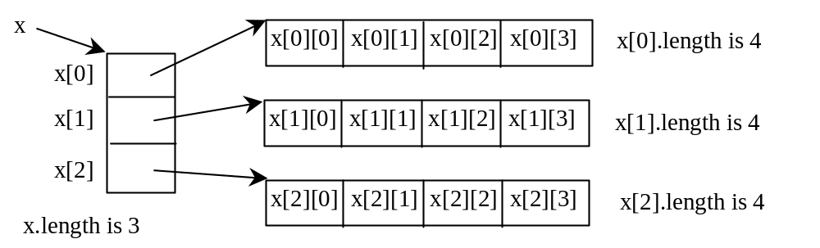
Lengths of Two-dimensional Arrays
int[][] x = new int[3][4];

Slide 63
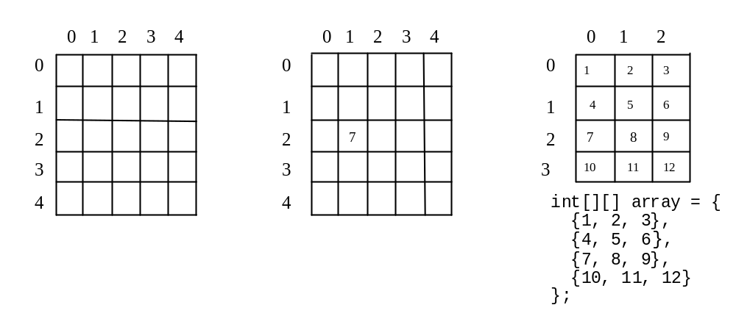
Two-dimensional Array Illustration
int[][] matrix = new int[5][5];
matrix.length? 5
matrix[0].length? 5
matrix[2][1] = 7
array.length? 4
array[0].length? 3

Slide 64
Declaring, Creating, and Initializing Using Shorthand Notations
You can also use an array initializer to declare, create and initialize a two-dimensional array. For example,
int[][] array = {
{1, 2, 3},
{4, 5, 6},
{7, 8, 9},
{10, 11, 12}
};
int[][] array = new int[4][3];
array[0][0] = 1; array[0][1] = 2; array[0][2] = 3;
array[1][0] = 4; array[1][1] = 5; array[1][2] = 6;
array[2][0] = 7; array[2][1] = 8; array[2][2] = 9;
array[3][0] = 10; array[3][1] = 11; array[3][2] = 12;
Same as

Slide 65
Lengths of Two-dimensional Arrays, cont.
int[][] array = {
{1, 2, 3},
{4, 5, 6},
{7, 8, 9},
{10, 11, 12}
};
array.length
array[0].length
array[1].length
array[2].length
array[3].length
array[4].length ArrayIndexOutOfBoundsException

Slide 66
Ragged Arrays
Each row in a two-dimensional array is itself an array. So, the rows can have different lengths. Such an array is known as a ragged array. For example,
int[][] matrix = {
{1, 2, 3, 4, 5},
{2, 3, 4, 5},
{3, 4, 5},
{4, 5},
{5}
};
matrix.length is 5
matrix[0].length is 5
matrix[1].length is 4
matrix[2].length is 3
matrix[3].length is 2
matrix[4].length is 1

Slide 67
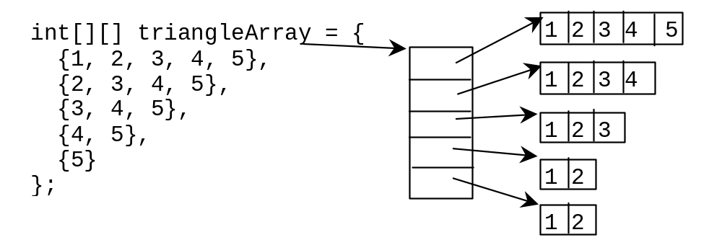
Ragged Arrays, cont.

Slide 68
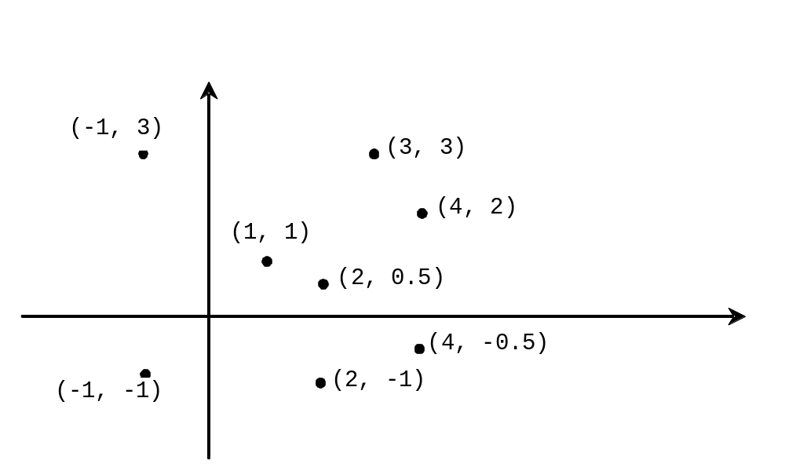
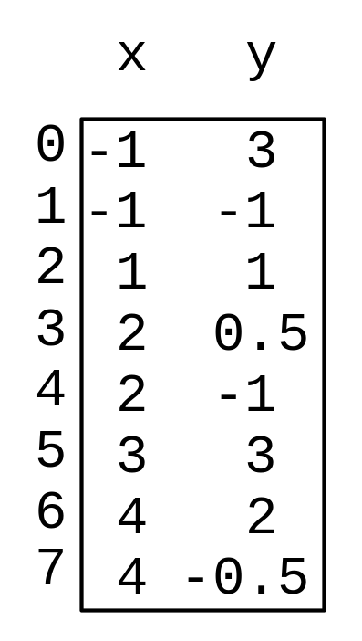
Example: Finding Two Points Nearest to Each Other

Slide 69
Multidimensional Arrays
Occasionally, you will need to represent n-dimensional data structures. In Java, you can create n-dimensional arrays for any integer n.
The way to declare and create two-dimensional arrays can be generalized to declare and create n-dimensional arrays.
For example, the following syntax declares a three-dimensional array variable scores, creates an array, and assigns its reference to scores.
  double[][][] scores = new double[10][5][2];

Slide 70
Example: Calculating Total Scores
Objective:
  Write a program (TotalScore) that calculates the total score for students in a class.
  Suppose the scores are stored in a three-dimensional array named scores.
  The first index in scores refers to a student, the second refers to an exam, and the third refers to the part of the exam.
  Suppose there are 7 students, 5 exams, and each exam has two parts -- the multiple-choice part and the programming part.
  Example, scores[i][j][0] represents the score on the multiple-choice part for the i’s student on the j’s exam.
  Your program displays the total score for each student.

